Slide 1
Performance of Tennis Players
Notes:
Collect data in the domain of sports based on opinion poll of your choice on performance of two players in the game over the years (or a player over his overall career) and present your views with necessary statistical numbers as appropriate.

Slide 2
SCOPE
SPORTS | TENNIS
TIME PERIOD | 2007-2017
Sportsman 1 | Rafael Nadal
Sportsman 2 | Roger Federer
Data Source | https://datahub.io/sports-data/atp-world-tour-tennis-data
2017 Tennis Dashboard
Year | Month | Tournaments played | Playerage | Player Name | Ranking points | Rank number
2017 | 11 | 18 | 31 | Rafael nadal | 10645 | 1
2017 | 11 | 17 | 36 | Roger federer | 9605 | 2
2017 | 11 | 23 | 26 | Grigor dimitrov | 5150 | 3
2017 | 11 | 25 | 20 | alexander zverev | 4610 | 4
2017 | 11 | 27 | 24 | dominic thiem | 4015 | 5
2017 | 11 | 22 | 29 | marin cilic | 3805 | 6
2017 | 11 | 26 | 26 | david goffin | 3775 | 7
2017 | 11 | 22 | 25 | jack sock | 3165 | 8
2017 | 11 | 15 | 32 | stan wawrinka | 3150 | 9
2017 | 11 | 25 | 26 | pablo carreno | 2615 | 10
2017 | 11 | 19 | 29 | juan martin potro | 2595 | 11
2017 | 11 | 16 | 30 | novak djokovic | 2585 | 12
2017 | 11 | 23 | 30 | sam querrey | 2535 | 13
2017 | 11 | 22 | 31 | kevin anderson | 2480 | 14
2017 | 11 | 20 | 32 | jo wilfried tsonga | 2320 | 15
Notes:
This dataset contains tennis data from the ATP World Tour website. The data is updated annually in October. The data contains ATP tournaments, match scores, match stats, rankings and players overview. The latest available data is for 2017.
Association of Tennis Professionals -Ranking points are awarded according to the stage of tournament reached, and the prestige of the tournament, with the four Grand Slams awarding the most points.
Tennis is a racket sport that can be played individually against a single opponent (singles) or between two teams of two players each (doubles). Each player uses a tennis racket that is strung with cord to strike a hollow rubber ball covered with felt over or around a net and into the opponent's court. The object of the game is to maneuver the ball in such a way that the opponent is not able to play a valid return. The player who is unable to return the ball will not gain a point, while the opposite player will

Slide 3
Variable Type Identification
Contents
Variable
Type Identification
One Variable Analysis
Player -1
Player -2
Tools Used &
Justification
Inference
Two Variable Analysis
Comparison Study
Inference
Attributes | Data Type
Player_Name | Qualitative | Nominal
Player_age | Quantitative | Ratio
Year | Quantitative | Interval
Month | Quantitative | Interval
Tournaments_played | Quantitative | Ratio
Ranking_points | Quantitative | Ratio
Rank_number | Qualitative | Ordinal

Slide 4
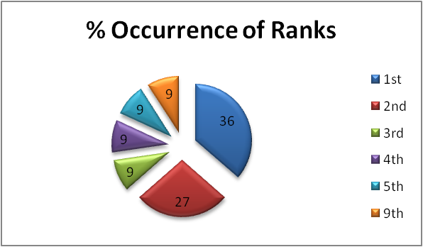
PLAYER – 1 : One Variable Analysis
Year | Tournaments played | Ranking_points | Rank number
2007 | 19 | 5735 | 2
2008 | 19 | 6675 | 1
2009 | 19 | 9205 | 2
2010 | 20 | 12450 | 1
2011 | 20 | 9595 | 2
2012 | 18 | 6690 | 4
2013 | 20 | 13030 | 1
2014 | 19 | 6835 | 3
2015 | 23 | 5230 | 5
2016 | 16 | 3300 | 9
2017 | 18 | 10645 | 1

Slide 5
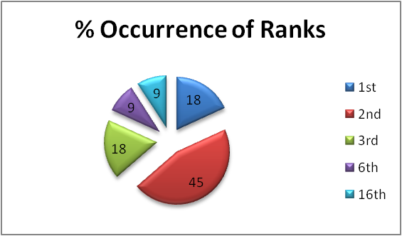
PLAYER – 2 : One Variable Analysis
Year | Tournaments played | Ranking_points | Rank_number
2007 | 16 | 7180 | 1
2008 | 19 | 5305 | 2
2009 | 19 | 10550 | 1
2010 | 21 | 9145 | 2
2011 | 19 | 8170 | 3
2012 | 21 | 10265 | 2
2013 | 19 | 4205 | 6
2014 | 19 | 9775 | 2
2015 | 18 | 8265 | 3
2016 | 15 | 2130 | 16
2017 | 17 | 9605 | 2

Slide 6
Tools Used & Justification
Attributes | Tournaments played | Ranking points | Rank number
Data type | Quantitative | Quantitative | Ordinal
Data Representation | Tabular, Ungrouped | Tabular, Ungrouped | Frequency Distribution Table, Ungrouped
Data Scattering | Distributed Symmetric data | Distributed Data | Skewed data
Data Visualization | Bar Graph | Bar Graph | Pie Chart
Mean | Relevant | Relevant | Not Applicable
Median | Relevant | Relevant | Relevant
Mode | Relevant | Not Applicable | Relevant
Max | Relevant | Relevant | Relevant
Min | Relevant | Relevant | Relevant
Range | Relevant | Relevant | Relevant
SD | Not Required | Relevant | Not Applicable

Slide 7
INFERENCE
Player | Rafael | Roger | Rafael | Roger | Rafael | Roger
Attributes | Tournaments_played |  | Ranking_points |  | Rank_number
Mean | 19.18 | 18.45 | 8126 | 7690 | NA | NA
Median | 19 | 19 | 6835 | 8265 | 2 | 2
Mode | 19 | 19 | NA | NA | 1 | 2
Max | 23 | 21 | 13030 | 10550 | 9 | 16
Min | 16 | 15 | 3300 | 2130 | 1 | 1
Range | 7 | 6 | 9730 | 8420 | 8 | 15
SD | NR | NR | 3092 | 2729 | NA | NA
During 2007-2017, Rafael & Roger have played a total of 211 & 203 tournaments in Tennis respectively.
Every year, Rafael & Roger participate in 19 tournaments on an average.
Rafael’s average Ranking score is higher than Roger’s average Ranking score by 436 points
Rafael’s wide variation in ranking score suggests extremities
In the last 11 years , Rafael has secured 1 st Rank 4 times, whereas Roger has managed it twice.

Slide 8
Two Variable Analysis
 | Tournaments_played |  | Ranking_points |  | Rank_number
Year | Rafael | Roger | Rafael | Roger | Rafael | Roger
2007 | 19 | 16 | 5735 | 7180 | 2 | 1
2008 | 19 | 19 | 6675 | 5305 | 1 | 2
2009 | 19 | 19 | 9205 | 10550 | 2 | 1
2010 | 20 | 21 | 12450 | 9145 | 1 | 2
2011 | 20 | 19 | 9595 | 8170 | 2 | 3
2012 | 18 | 21 | 6690 | 10265 | 4 | 2
2013 | 20 | 19 | 13030 | 4205 | 1 | 6
2014 | 19 | 19 | 6835 | 9775 | 3 | 2
2015 | 23 | 18 | 5230 | 8265 | 5 | 3
2016 | 16 | 15 | 3300 | 2130 | 9 | 16
2017 | 18 | 17 | 10645 | 9605 | 1 | 2

Slide 9
PLAYER – 1 & 2 Analysis

Slide 10
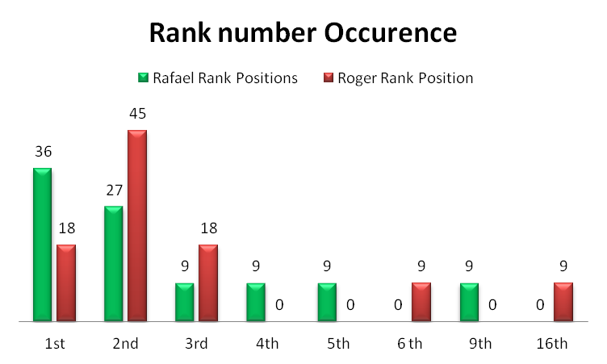
Comparison between Players | Data Type |  | Graph | Box Plots
Tournaments played | Quantitative | Ratio
Ranking points | Quantitative | Ratio
Rank number | Qualitative | Ordinal

Slide 11
Tournaments Played | Rafael | Roger
Min | 16 | 15
Q1 | 18 | 17
Median | 19 | 19
Q3 | 20 | 19
Max | 23 | 21
Ranking Points
Min Q1 Q2 Q3 Max
Ranking Points | Rafael | Roger
Min | 3300 | 2130
Q1 | 5735 | 5305
Median | 6835 | 8265
Q3 | 10645 | 9775
Max | 13030 | 10550
Min Q1 Q2 Q3 Max

Slide 12
INFERENCE
Tournaments Played
From the Box plot, it is evident that Rafael & Roger have
played approximately similar number of tournaments
from 2007-2017 (with +/-1 variation only)
Ranking Score
Rafael & Roger had a wider distribution of ranking Score.
Rafael’s extremities in ranking score primarily driven by
Loss in Australian Open & Roger’s extremities due to
Game injury

